Slide 1

Mushrooms
Alex Trimiew

Slide 2



Agenda
Our stakeholders
The Problem
The Process
What we found
Recommendations

Slide 3
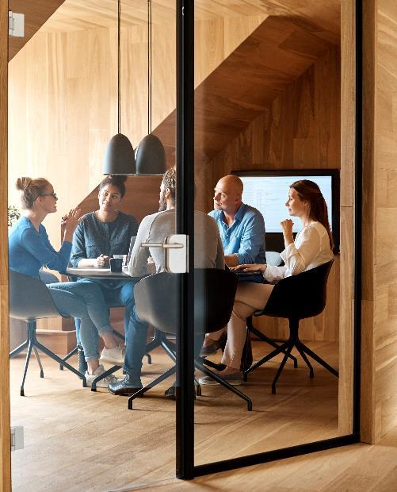



Introduction
Hello, today we are working with our stakeholders at Umbrella corp. medical to study the benefits of mushrooms. Our first step in this mission is to effectively and efficiently find which are safe for consumption and study.

Slide 4

Our stakeholders
We are proud to work for a company like the Umbrella corporation whose sole mission is to improve people’s quality of life by providing the best in medical advancements through forward and innovative thinking in their research.

Slide 5
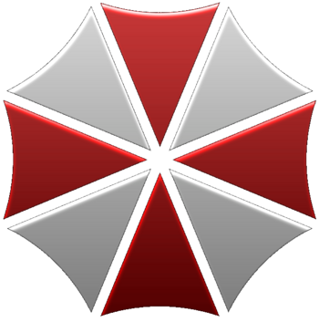
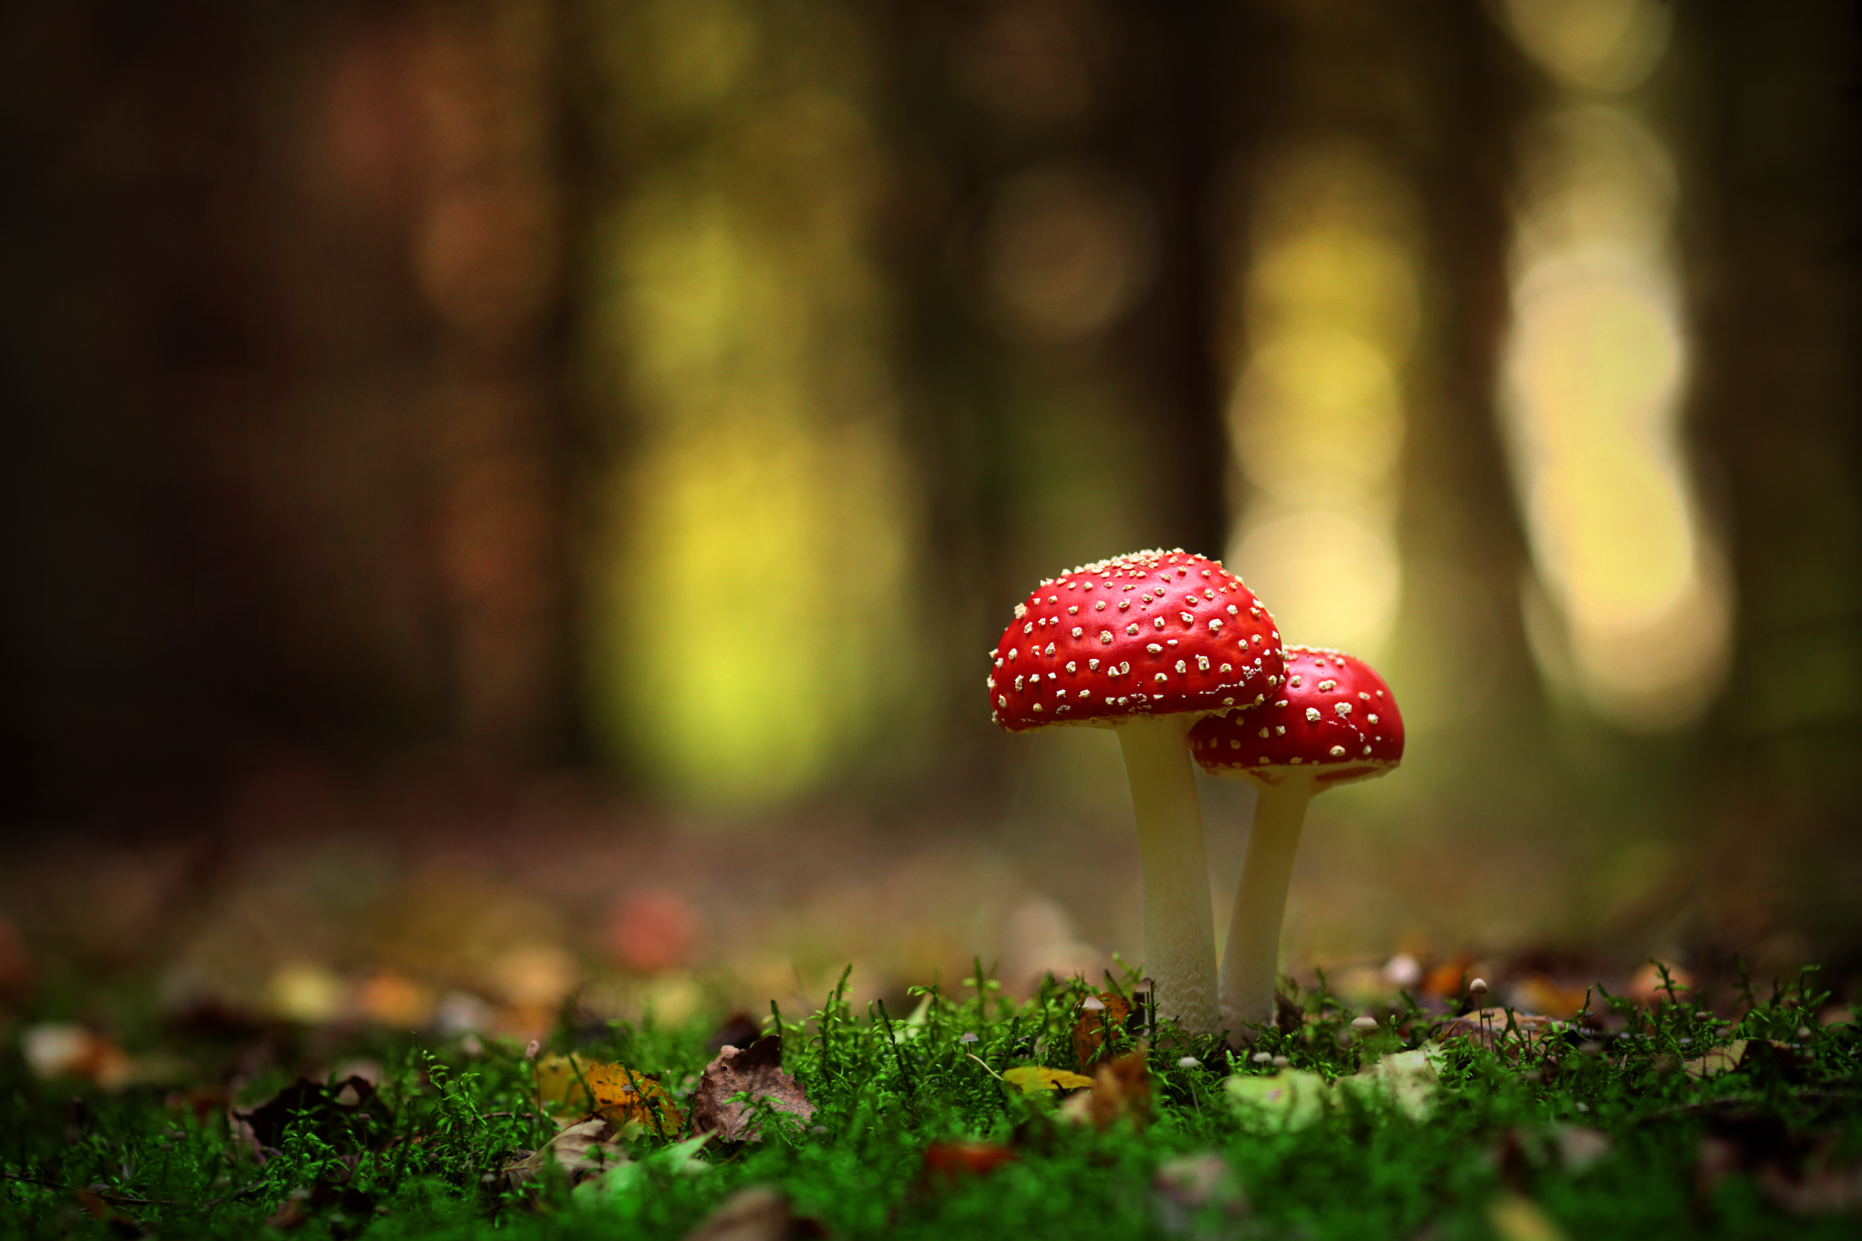
The Problem We need to find the best model to find which mushrooms are safe for study with human testing

Slide 6
The Process The following models were created to test how well we could classify the safe and not so safe mushrooms 1. K nearest neighbors or KNN for short due to the simplicity and good accuracy 2. Random forest classifier to see if it was anymore or less accurate 3. Tested the pipelines with and without PCA to see if we could add value to the model through faster processing

Slide 7
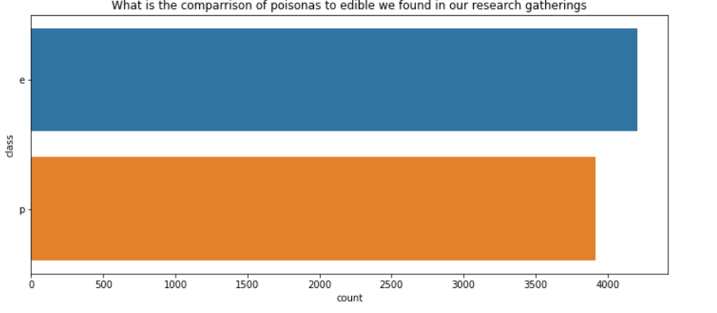
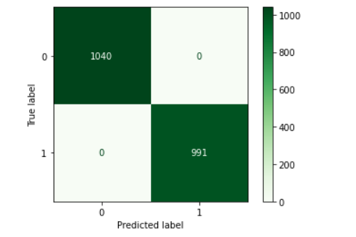
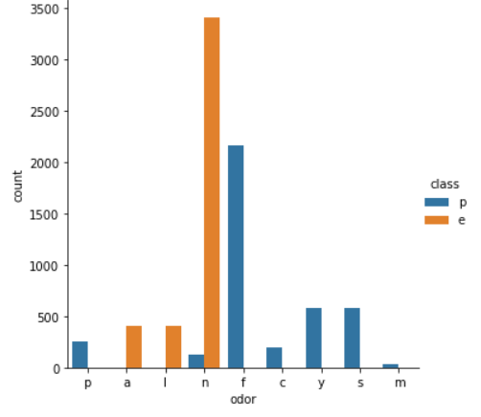
What we found
Our model was able to find the true negatives and true positives perfectly which will earn trust with our stakeholders in building a respected brand
Ratio of poisonous and edible mushrooms
We were even able to find that mushrooms stronger odors are generally unsafe

Slide 8

Recommendations
In the end I found that,
The model I tested was very accurate in finding which mushrooms were safe and useful for medical trails with humans
Random Forrest and KNN were used and compared to see which was more accurate but also more efficient for cost effectiveness
The KNN model was the best when used with PCA since it made the model 40 % more efficient without sacrificing accuracy

Slide 9


Thank You
Alex Trimiew
Coding Dojo
codepuple88@outlook.com

